Slide 1
Computer Graphics
Shaders

Slide 2
Working in Screen/Pixel Space
Pros
Cons
1 unit = 1 pixel, distance is easy to understand.
Working with 2D sprites is straightforward.
You can operate completely in whole numbers if you want to.
A direct representation of what you see.
The raster has no Z it is completely 2D.
Y is going “down” instead of “up” unlike most mathematical Cartesian representations.
Translating or rotating vector shapes using integers alone could cause significant errors and information loss.
Everything is resolution dependent!
Insufficient information available to represent a fully 3D environment.

Slide 3
Working in 3D Space
Pros
Cons
A virtual 3D representation of all the things you “could” see!
Full 3D Rotation, Translation and Scaling is possible without truncation errors!
1 unit = Whatever you want as long as you are consistent! (feet, meters, yards…)
Independent of 2D raster resolution!
Not as direct when working in 2D alone.
Requires Rasterization: The conversion of vector coordinates to raster coordinates so shapes can actually be drawn.
More complex to understand.

Slide 4
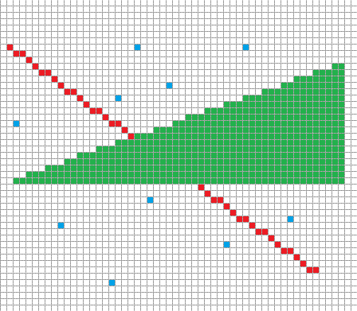
Rasterization

Slide 5
The Screen in 3D Normalized Device Coordinates
+1Y
+1Z
A.K.A The Canonical View Volume.
This coordinate system is always the same regardless of what you set your screen pixel width & height.
Notice how the origin is now in the center and that we have a Z axis available.
As we start to work in 3D this system will be much easier to deal with.
-1X
+1X
-1Z
-1Y

Slide 6
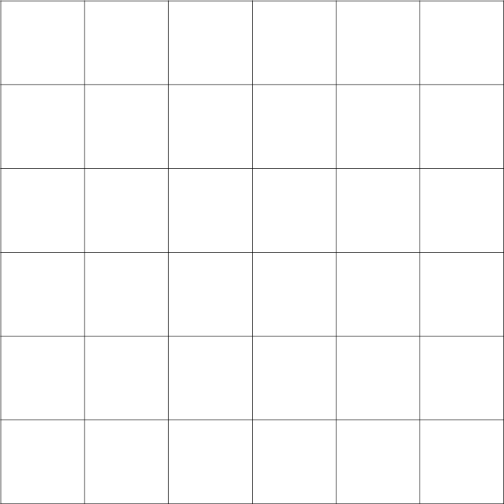
Exercise: Coordinate Conversion
+1Y
Width 6 pixels
*
XYZ
( -0.3,+0.7 +0.3 )
+1Z
X1 Y1 ( 2.1, 0.9 )
-1X
+1X
Height 6 pixels
XYZ
( +0.4,-0.6 ,-0.3 )
X2 Y2 ( 4.2, 4.89 )
-1Z
1
3
-1Y
*Add +0.5 to round to pixel centers

Slide 7
Using 3D to Our Advantage
We will learn many ways to take advantage of this new system.
To start we will need a better way to represent a location in this space.
A “Vertex” representing where two edges meet will be very convenient.
Coding Tip: struct VERTEX { float xyzw[4]; uint color; }
We won’t really capitalize on the Z or W today, but they will be useful later…
Once our shapes are stored in this 3D Space, it will be easier for us to rotate them around the screen center. (now the origin)

Slide 8
Review: 3x3 Rotation Matrices
Identity
[
1, 0, 0,
0, 1, 0,
0, 0, 1, ]
X Rotation
[
1, 0, 0,
0, cosθ, -sinθ,
0, sinθ, cosθ,
]
Y Rotation
[
cosθ, 0, sinθ,
0, 1, 0,
-sinθ, 0, cosθ,
]
Z Rotation
[
cosθ, -sinθ, 0,
sinθ, cosθ, 0,
0, 0, 1,
]
Vector3
[
X,
Y,
Z,
]
Matrix3x3
[
A, B, C,
D, E, F,
G, H, I,
]
Vector3
[
XA + YD + ZG,
XB + YE + ZH,
XC + YF + ZI,
]
Notes:
Discuss different terms, Square, Orthogonal, Orthonormal, Affine, Singular/Degenerate
Square : Equal number of rows and columns
Orthogonal: Perpendicular vectors
Orthonormal: Perpendicular and Unit Length vectors
Affine transformation preserves angles and lengths.
Singular/Degenerate: Square matrix that is non-invertible that has a determinant of zero

Slide 9
Adding Flexibility: Shaders
Currently if you draw a line… you draw EXACTLY that line…
Wouldn't it be useful to draw the same line in a different spot without having to remake it? What if we wanted to do this every frame?
What if multiple lines needed to move or rotate together as a group?
What if we wanted to temporarily draw the line a different color?
Perhaps our vector “spaceship” takes some damage and should flash red!
Shaders are customizable and “interchangeable” functions that intercept & modify data right before we draw it to the screen.

Slide 10
Shaders in Action!
VS_SpinMe ( VERTEX V )
V = RotateVertex ( V, MATRIX M )
PS_Red ( COLOR C )
C = 0xFFFF0000
DrawAPixel ( X, Y, COLOR Q )
Q = PixelShader ( Q )
FrameBuffer [ Y ][ X ] = Q
FunctionPointer VertexShader
FunctionPointer PixelShader
DrawLine ( VERTEX A, VERTEX B )
CopyA = A
CopyB = B
VertexShader ( CopyA )
VertexShader ( CopyB )
CartesianToPixel ( CopyA )
CartesianToPixel ( CopyB )
…
FOR CopyA TO CopyB
DrawAPixel ( X, Y, Q )
MainLoop
VERTEX MyLine[ 2 ]
VertexShader = VS_SpinMe
PixelShader = PS_Red
DrawLine ( MyLine [ 0 ], MyLine[ 1 ] )

Slide 11
Shaders.h
Rasterization_Functions.h
// The active vertex shader. Modifies an incoming vertex. Pre-Rasterization.
void (*VertexShader)( MY_VERTEX& ) = 0;
// The active pixel shader. Modifies an outgoing pixel. Post-Rasterization.
void (*PixelShader)( A_PIXEL& ) = 0;
// All Shader Variables (Always Pre-fixed by “SV_”)
MY_MATRIX_3X3 SV_WorldMatrix;
// Various custom vertex and pixel shaders, (Pre-fixed by “VS_” & “PS_”)
// Can be swapped using above function pointers as needed for flexibility.
// Applys the current world matrix to all
void VS_World( MY_VERTEX &multiplyMe )
{
MultiplyVertexByMatrix( multiplyMe, SV_WorldMatrix );
}
// Basic pixel shader returns the color white
void PS_White( A_PIXEL &makeWhite)
{
makeWhite = 0xFFFFFFFF;
}
// Draws a line using one of the line equations.
void DrawLine( const MY_VERTEX &start, const MY_VERTEX &end )
{
// Copy input data and send through shaders
MY_VERTEX copy_start = start;
MY_VERTEX copy_end = end;
// Use vertex shader to modify incoming copies only.
if ( VertexShader )
{
VertexShader( copy_start );
VertexShader( copy_end );
}
// original plotting variables adapted to use new cartesian data
SCREEN_XY screen_start = CartesianToScreen( copy_start );
SCREEN_XY screen_end = CartesianToScreen( copy_end );
// Standard line drawing code follows using integer coordinates...
for( numPixels )
{
A_PIXEL copyColor = currColor; // Just like a Vertex, copy original.
if ( PixelShader ) PixelShader( copyColor ); // Modify copy.
PlotPixel( currX, currY, copyColor ); // Display the copy.
}
}
Main.cpp
// Main program loop.
void main( void )
{
// Initialize constant drawing data. (BE SURE IT IS CONSTANT!!!)
const MY_VERTEX UnEditableOriginalLine[ 2 ] =
{
{ -0.5, +0.5 }, { +0.5, -0.5 } // Defines a fixed diagonal line crossing the origin.
};
// Enter the main drawing loop...
while ( Am_Drawing )
{
// Select appropriate Shaders you want to Use. REMEMBER! You can make as many as you want!
// Only ever having one type of shader defeats the purpose! (This exists for flexibility!)
VertexShader = VS_World; // I choose a shader that will multiply by a single matrix that I control.
PixelShader = PS_White; // Regardless of the original color I want all pixels to be shown white.
// Set any custom variables used by the shader functions so you can control shader behaviors directly!
SV_WorldMatrix = BuidRotationMatrixOnAxisZ( GetIncreasingRadiansOverTime() );
// With appropriate shaders chosen we draw the fixed line. (A copy will be modifed by shaders)
DrawLine( UnEditableOriginalLine[ 0 ], UnEditableOriginalLine[ 1 ] );
}
// Exit program...
}

Slide 12
Applicable Reading Assignment
For next time read:
In Chapter 5 Linear Algebra:
Read sections 5.1, 5.3
In Chapter 6 Transformation Matrices
Read sections 6.3 – 6.5
In Chapter 7 Viewing:
Read sections 7.1 – 7.5

